Slide 1
Modern site and Teams provisioning across a Bot, SPFx, Azure Function and Microsoft Flow
Giuliano De Luca
Notes:
This slide is mandatory. Please do not remove.

Slide 2

Giuliano De Luca
Software Engineer Technical Architect
Independent
https://delucagiuliano.com
@giuleon
Microsoft MVP for Office Development

Slide 3
Notes:
This slide is mandatory. Please do not remove and try to use it during Q&A at the end of your session. Thank you!

Slide 4
WiFi Keys for Attendees
Connect to the wireless network MSFT_GUEST
Login details for the wireless network:
Guest Username O365Sat@outlook.com
Guest Password: 0195

Slide 5
Agenda
Solution Business Use Case
Solution Architecture
Demo on Microsoft Teams
Bot
SharePoint Framework
Microsoft Flow
Azure Function
Azure Key Vault
Demo on a SharePoint online site
@giuleon
delucagiuliano.com

Slide 6
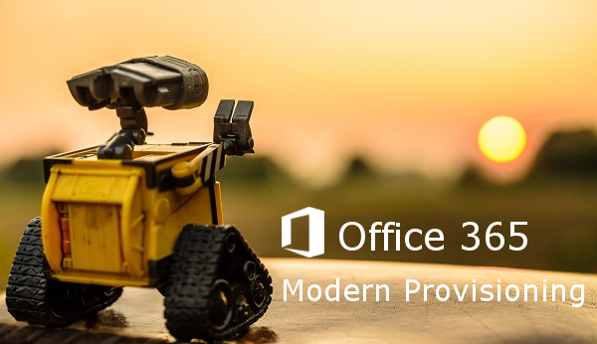
Typical Business Use case:
User is able to request a new SharePoint Team Site, Communication Site or Microsoft Teams
Admin approves
The entire process is automated
@giuleon
delucagiuliano.com

Slide 7
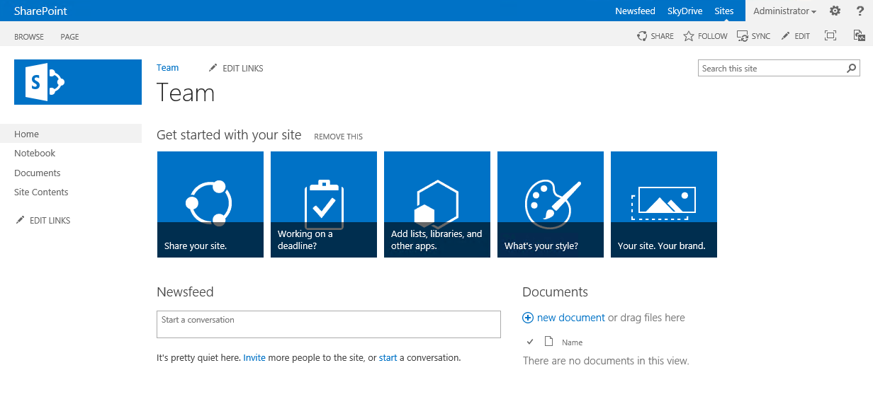











Solution Architecture
SharePoint Online
The Bot saves the user's request in a SharePoint list
The user requests a new SharePoint team site, communication or teams across a Bot
The admin approves the request which triggers a Microsoft Flow
3
2
Azure Key Vault
1
4
5
Flow for every request with status “Approved” will call an Azure Function to perform the provisioning
Flow notifies to the user that the process is ended
@giuleon
delucagiuliano.com

Slide 8
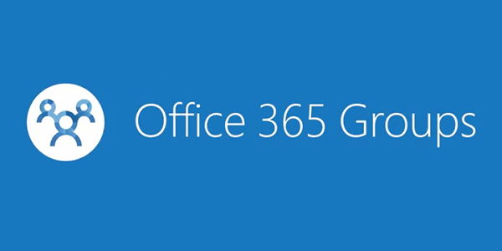
Define Good Governance

Slide 9
Demo on Microsoft Teams
Asking a new Team
@giuleon
delucagiuliano.com

Slide 10


What is a Bot?
A bot is an app that users interact with in a conversational way using text, graphics (cards), or speech.
Web Service
Build your Bot with the language that you prefer C# or Node.js.
Implement AI across Microsoft Cognitive Services.
Bot Framework Emulator
Make use of a native UI with Adaptive Cards
Enable the conversation with Channels

Slide 11
SharePoint Framework
Modern client-side development
Lightweight web and mobile
Powers our own experiences
Backward compatible
Supports open source tools and JavaScript web frameworks
Client Side Web Parts
SPFx Extension
Application Customizer
Field Customizer
Command Sets
S
P
F
X

Slide 12





S
P
F
X
SharePoint Framework Toolchain
Tooling
Node.js
Yeoman
Gulp
TypeScript
Visual Studio (Code)
Frameworks – Choose yours
React
Angular.js
Knockout
Etc.

Slide 13


Microsoft Flow
Create automated workflows between your favorite apps and services to get notifications, synchronize files, collect data, and more
Turn repetitive tasks into multistep workflows
Flow templates available flow.microsoft.com
All services integration are possible
Office 365
Microsoft Graph API
Custom API
Microsoft Account Free or Office 365 or Dynamics 365 or PowerApps

Slide 14


Azure Function
Serverless
Pay-per-use
0,17 € per one million requests
App Service Plan
Running pieces of code / Scripts in the cloud
Use the language that you prefer
C#, Node.js (Javascript), F#, Python, PHP, Powershell, Java
Triggers
Blob storage
Azure Cosmos DB
Timer
Generic webhook
Github webhook
Queue storage

Slide 15


Azure Key Vault
Cloud service that works as a secure secrets store
Passwords, Connection strings and other info
Information is encrypted in a container called Vault
Monitor access and use
Create a Key Vault:
Azure CLI
Powershell
Azure Portal
Price 0,026 € per 10,000 operations

Slide 16
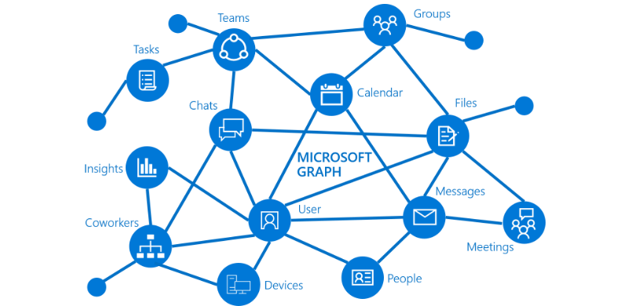
Microsoft Graph
Microsoft Graph exposes APIs for:
Azure Active Directory
Office 365 services: SharePoint, OneDrive, Outlook/Exchange, Microsoft Teams, OneNote, Planner, and Excel
Enterprise Mobility and Security services: Identity Manager, Intune, Advanced Threat Analytics, and Advanced Threat Protection.
Windows 10 services: activities and devices
Education
Use the Microsoft Graph API to connect to the data that drives productivity – mail, calendar, contacts, documents, directory, devices, and more.

Slide 17
Demo on SharePoint Online
Asking a new SharePoint Team Site
@giuleon
delucagiuliano.com

Slide 18


Slide 19
Notes:
This slide is mandatory. Please do not remove and try to use it during Q&A at the end of your session. Thank you!

Slide 20
Thank you for attending me
and enjoy my solution on GitHub
https://github.com/giuleon/O365ModernProvisioning
Giuliano De Luca

